Slide 1
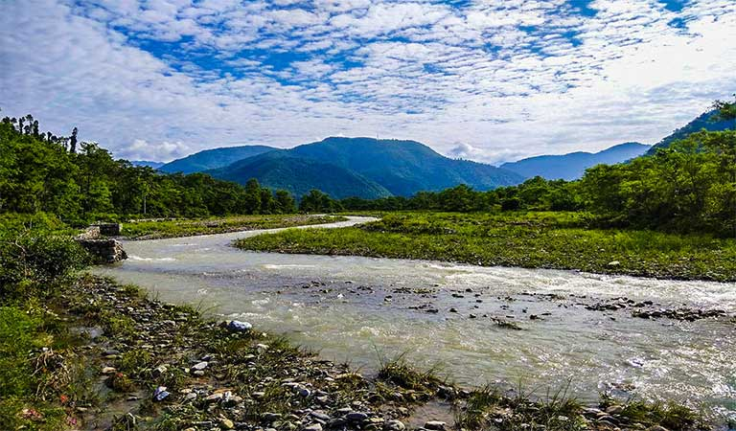
River Pollution
Maldevta river ,Dehradun

Slide 2
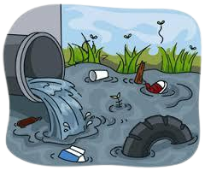
Introduction
Rivers are a vital source of freshwater and play a crucial role in sustaining the natural environment, supporting ecosystems, and providing water for human use. However, in recent years, rivers have become increasingly polluted due to human activities, including industrial processes, agriculture, and urbanization.
River pollution is a significant environmental issue that has serious implications for human health, aquatic life, and the environment. This pollution can affect the quality of water, reduce the amount of dissolved oxygen, and introduce toxic chemicals that can contaminate the food chain. In this context, it is important to understand the sources, impacts, and solutions to river pollution to ensure the sustainability of these critical water bodies for future generations.

Slide 3

Objective
Protecting human health and aquatic life
One of the primary objectives of addressing river pollution is to protect human health. Contaminated water can lead to a range of health problems, from minor skin irritations to serious illnesses such as cholera and typhoid fever.
Rivers are home to a wide variety of aquatic life, including fish, amphibians, and invertebrates. Pollution can harm or kill these organisms, leading to disruptions in the food chain and ecological imbalances.

Slide 4
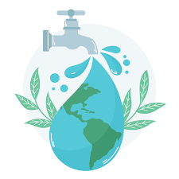
Objective
Improving water quality and access to clean water
Addressing river pollution aims to improve water quality by reducing the levels of pollutants present in the water. This can involve implementing measures to reduce the amount of pollution entering the river or removing pollutants already present in the water.
Rivers are an important source of freshwater for many communities, and addressing pollution can help ensure that people have access to clean, safe drinking water.

Slide 5

Objective
Protecting the environment
Rivers are a critical component of the environment, providing habitats for wildlife and supporting ecosystems. Reducing pollution can help protect the natural environment and ensure the long-term sustainability of these ecosystems.

Slide 6
Literature Review
Sources of River Pollution:
Several studies have identified the sources of river pollution. A study by Rattan et al. (2021) identified industrial discharge as a major source of pollution in the Ganga River in India. The study found that industries discharged large amounts of heavy metals, organic pollutants, and nutrients into the river, causing significant environmental degradation. Another study by Zhang et al. (2020) identified agricultural runoff as a major source of pollution in the Yangtze River in China. The study found that agricultural activities, such as fertilizer application and livestock farming, contributed to high levels of nutrients and pesticides in the river.

Slide 7
Literature Review
Impacts of River Pollution:
The pollution of rivers has severe consequences on both human health and aquatic life. A study by WHO (2018) reported that contaminated water is responsible for the deaths of 485,000 people worldwide every year. The study found that polluted water can cause diseases such as diarrhea, cholera, and typhoid fever. River pollution also has significant impacts on aquatic life. A study by Lee et al. (2020) found that high levels of nitrogen and phosphorus in rivers can lead to algal blooms, which deplete oxygen levels and harm fish and other aquatic organisms.

Slide 8
Literature Review
Mitigation Measures:
Several strategies have been proposed to mitigate river pollution. One common approach is to reduce point source pollution by regulating the discharge of pollutants from industries and wastewater treatment plants. For example, a study by Linares-Palomino et al. (2021) found that the implementation of stricter regulations on industrial discharge in the Cauca River in Colombia led to a significant reduction in pollutant levels. Another approach is to control non-point source pollution by promoting sustainable agricultural practices and reducing littering. A study by Tsai et al. (2020) found that the use of cover crops in agricultural fields can significantly reduce nutrient runoff into rivers.

Slide 9
Methodology
Identify the objective of the project: This could be to determine the extent and sources of pollution in a particular river, to assess the impact of pollution on aquatic life and human health, to identify strategies to reduce pollution levels, or to raise awareness about the issue of river pollution.
Conduct a literature review: This involves gathering information on previous studies and reports on river pollution in the area. This can help identify the main pollutants, sources of pollution, and potential impacts on the ecosystem and human health.
Design a study plan: Based on the objective of the project, the study plan should include the sampling locations, sampling methods, analytical techniques, and data analysis methods. The plan should also consider ethical issues and safety precautions.

Slide 10
Methodology
Conduct fieldwork: This involves collecting water samples from different locations along the river and analyzing them for various pollutants such as nutrients, bacteria, pesticides, heavy metals, and organic chemicals. Field measurements of water quality parameters such as temperature, pH, dissolved oxygen, and turbidity may also be collected.
Analyze data: The collected data should be analyzed to identify trends and patterns in pollutant levels and water quality parameters. Statistical techniques such as regression analysis, correlation analysis, and principal component analysis may be used to identify relationships between different variables.
Interpret results: The results of the study should be interpreted in light of the research objective and the literature review. The implications of the findings for the environment and human health should be discussed.

Slide 11
Resultant Discussion
River pollution is a complex environmental issue that affects both developed and developing countries worldwide. It results from a range of human activities such as industrial processes, agriculture, urbanization, and domestic waste. As a result, it can have serious implications for human health, aquatic life, and the environment.
The impact of river pollution can vary from one location to another, depending on the type and amount of pollutants present in the water. These pollutants can be physical, chemical, or biological, and can come from point and non-point sources. Point sources are direct discharges of pollutants from specific locations such as factories, sewage treatment plants, and oil spills. Non-point sources are diffuse discharges that come from a broader area, such as agricultural runoff and stormwater runoff.

Slide 12
Resultant Discussion
The impact of river pollution can be devastating. It can result in the destruction of aquatic ecosystems, loss of biodiversity, and the decline in water quality. Polluted rivers can cause illness and disease in humans, leading to long-term health problems. Furthermore, it can lead to economic losses as businesses dependent on the river water, such as fishing and tourism, are affected.
Efforts to address river pollution have been ongoing for decades, but much more needs to be done. Governments, industries, and communities need to work together to reduce the amount of pollution entering rivers. One solution is to promote natural solutions such as riparian buffers and wetlands that can help filter pollutants and improve water quality. Furthermore, governments should strengthen regulations and policies to reduce the amount of pollution entering rivers, and increase funding for pollution control measures such as wastewater treatment plants and conservation practices.

Slide 13
Conclusion and Recommendation
Conclusion
River pollution is a serious environmental issue that affects water bodies worldwide. The sources of river pollution are numerous and varied, and the impacts can be far-reaching, affecting human health, aquatic life, and the environment. Despite the progress made in addressing river pollution, there is still much to be done to protect these critical water bodies.

Slide 14
Conclusion and Recommendation
Recommendation
To address river pollution, the following recommendations are suggested:
Strengthen regulations and policies: Governments and regulatory bodies should strengthen regulations and policies to reduce the amount of pollution entering rivers. This can include setting more stringent standards for water quality and enforcing penalties for non-compliance.
Increase funding for pollution control: More funding should be allocated to pollution control measures, such as wastewater treatment plants and conservation practices, to reduce the amount of pollution entering rivers.
Educate the public: Public education campaigns can help raise awareness of the impacts of river pollution and encourage individuals to take action to reduce pollution in their daily lives.

Slide 15
Conclusion and Recommendation
Recommendation
To address river pollution, the following recommendations are suggested:
Promote natural solutions: Natural solutions such as riparian buffers and wetlands can help filter pollutants and improve water quality. Promoting and implementing these solutions can help reduce pollution in rivers.
Encourage international cooperation: River pollution is a global issue, and international cooperation is needed to address it effectively. Governments, non-governmental organizations, and other stakeholders should work together to develop and implement pollution control measures.

Slide 16
References and Bibliography
Vymazal, J. (2017). River water quality: The role of riparian vegetation buffers. International Journal of Environmental Research and Public Health, 14(10), 1206.
Hejazi, R., Hajrasouliha, I., & Kazemi, Z. (2020). River pollution and its environmental impacts. Environmental Science and Pollution Research, 27(8), 7926-7936.
Kumar, S., & Malhotra, S. K. (2019). Assessment of River Pollution: A Review of Selected Indices. Journal of Environmental Science and Engineering, 61(1), 1-17.
Jabeen, H., Iqbal, S., & Shah, M. H. (2020). Water pollution: Major sources, management, and recent developments in analytical methods. Environmental Monitoring and Assessment, 192(2), 77.

